Slide 1
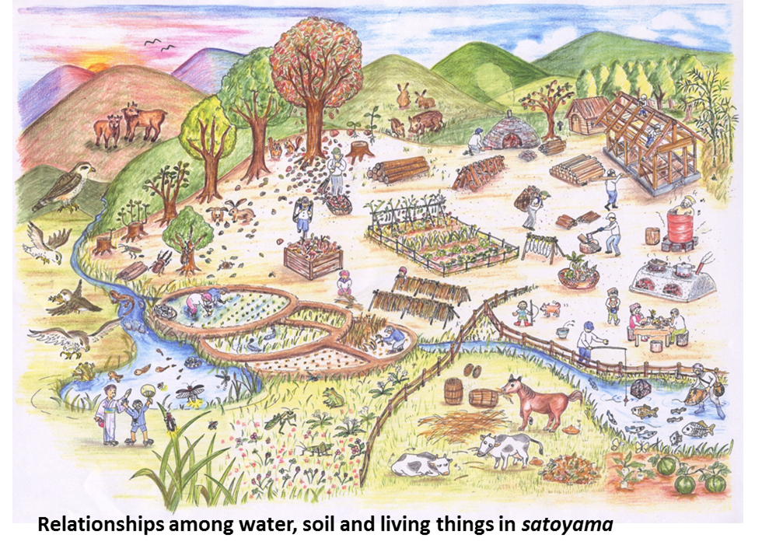
Our Ancient village map

